Slide 1

Battleship Artificial Intelligence Research
By:
Blake Diekmann, Jeremy Levine, Robert Mahoney, and Aidan Stiles

Slide 2

BATTLESHIP
`
Two player game, using a coordinate grid
Problem: The original implementation of AI Battleship did not display a physical heat map and the AI opening moves were hard-coded
Our goal was to implement a physical heat map that shows users where the AI is most likely to shoot next and update the AI opening moves for a true probabilistic random search algorithm

Slide 3

Solution
For our solution, we decided to use a probabilistic random search algorithm that utilized a probability grid to build a physical heat map displaying the algorithm's calculations and adjusted the opening attacks of the AI for better AI performance.
The weights of each position in the grid are calculated by the number of ways each ship in the roster legally fits into each position horizontally and vertically
Cells that surround known hits will be granted an arbitrarily high weight value to ensure the AI fully sinks the hit ship before moving on

Slide 4

AI Agent Design
Environment Type: Deterministic
Architecture: The player and the AI attack each other's 9x9 Battleship grid
Each "shot" cell on the grid alters the weight of the surrounding cells because the legality is altered
Each time the AI shoots the weight of the grid is recalculated
The heat map displays the calculated grid and determines the AI's most likely next move as well as the chance % it has of shooting each individual cell in the grid
Algorithms used: Probability-Based Random Search Algorithm

Slide 5
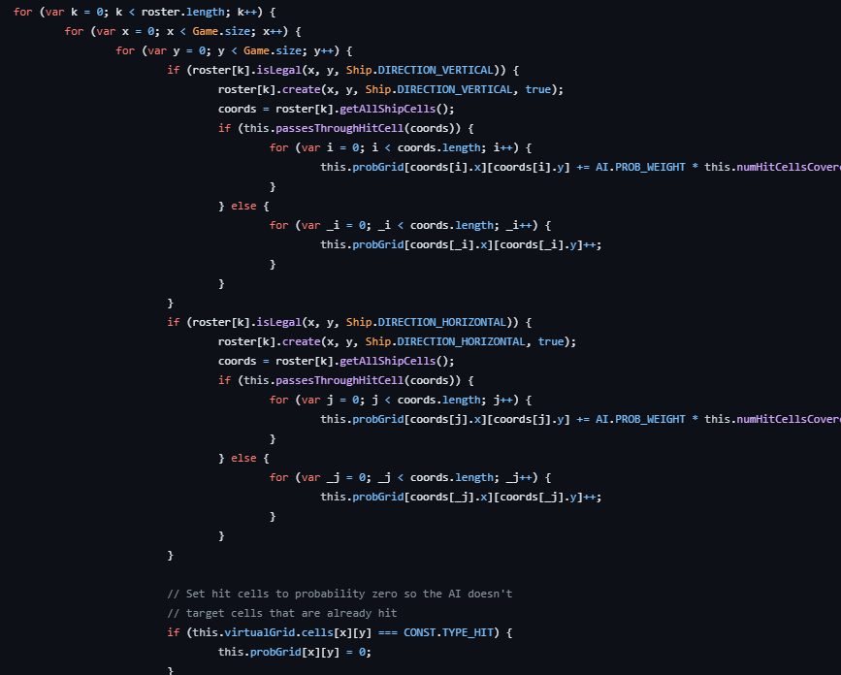
Random Probabilistic Algorithm Code:
Source: Mei, B, (n.d.).

Slide 6
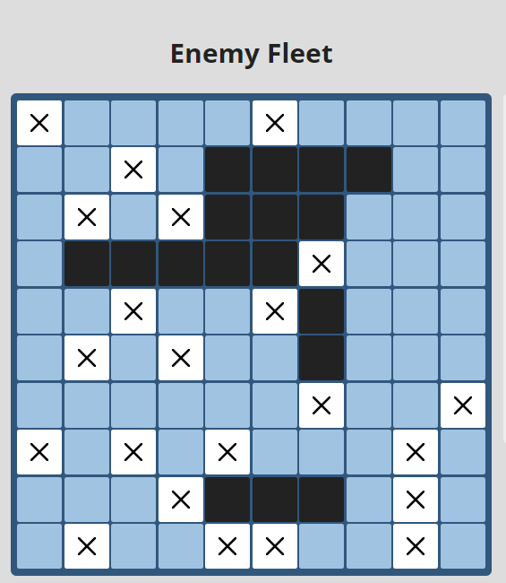

Results
Example of AI placing ships too close together
Corner ships were not shot very often
Shoots around the board evenly using a probabilistic random search function
AI still places ships too close to each other
Games won by user
Although the AI is competitive, it doesn't consistently beat a human

Slide 7
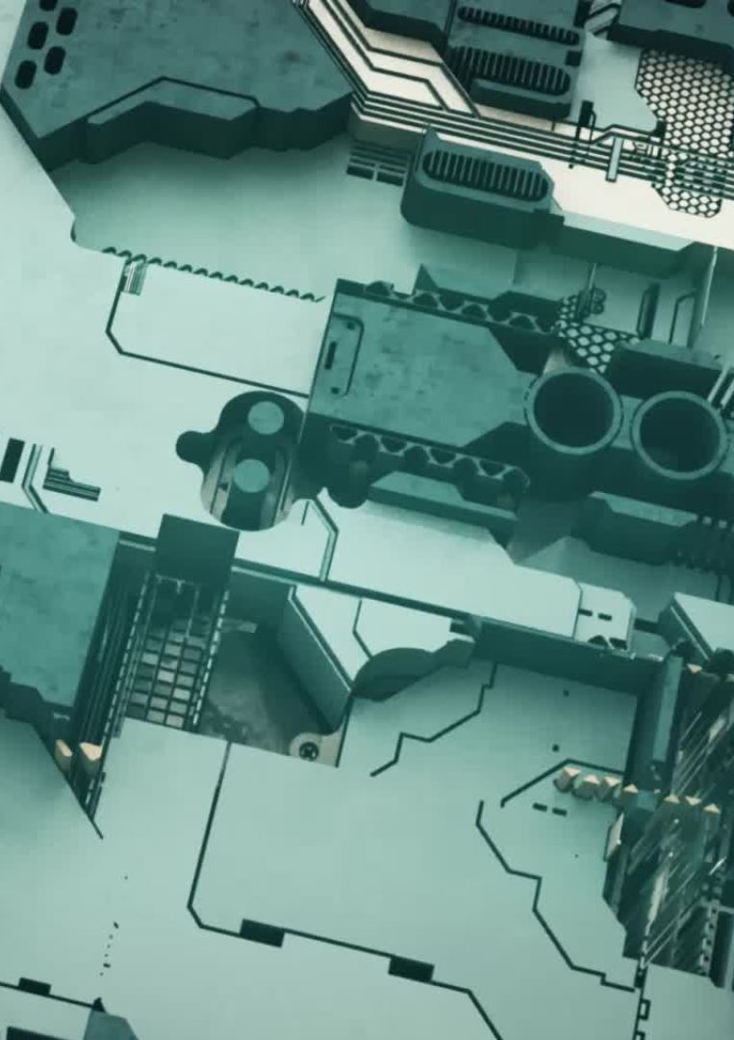
Implementation
Original Implementation by Bill Mei: Battleboat.js - A JavaScript AI that beats humans at battleship. (billmei.github.io)
Our Edited Implementation: https://github.com/AidanSt458/CS461-Team3
Lines of Code Altered:
CreateGrid function line 493
updateCell function lines 601 - 606
InitOpeningShot lines 975-981
Shoot function lines 1008 - 1054

Slide 8

Conclusion
Key Findings: Probabilistic Random Search Algorithms-How they work and how they can be improved, The Algorithm was not fully AI generated some of it was hard-coded and the AI did not perform well in the corners which we resolved by adding more randomness to the AI
Areas of Improvement: The AI often places their ships too close together, and the search algorithm could be modified to search for ships more efficiently if we were given more time to work on this project through researching and combining other search methods
If we were given more time, we would implement a more efficient random search algorithm on top of the existing algorithm

Slide 9

Questions?

Slide 10
Resources
Mei, B. (n.d.). Billmei/Battleboat: A javascript AI that beats humans at battleship. GitHub. https://github.com/billmei/battleboat
Schwartz, A. (2022, April 20). Coding an intelligent battleship agent. Medium. https://towardsdatascience.com/coding-an-intelligent-battleship-agent-bf0064a4b319

